Slide 1

CS312 Database Management Systems
School of Computer Engineering and Technology

Slide 2
CS312 Database Management Systems
Course Objectives:
Understand and successfully apply logical database design principles, including E-R diagrams and database normalization.
Learn Database Programming languages and apply in DBMS application
Understand transaction processing and concurrency control in DBMS
Learn database architectures, DBMS advancements and its usage in advance application
Course Outcomes:
Design ER-models to represent simple database application scenarios and Improve the database design by normalization.
Design Database Relational Model and apply SQL , PLSQL concepts for database programming
Describe Transaction Processing and Concurrency Control techniques for databases
Identify appropriate database architecture for the real world database application

Slide 3
LABORATORY ASSIGNMENT NO: 04
SQL- DDL commands( Create, Alter, Drop, Truncate, Rename, Describe) ,DCL(Grant, Revoke)

Slide 4
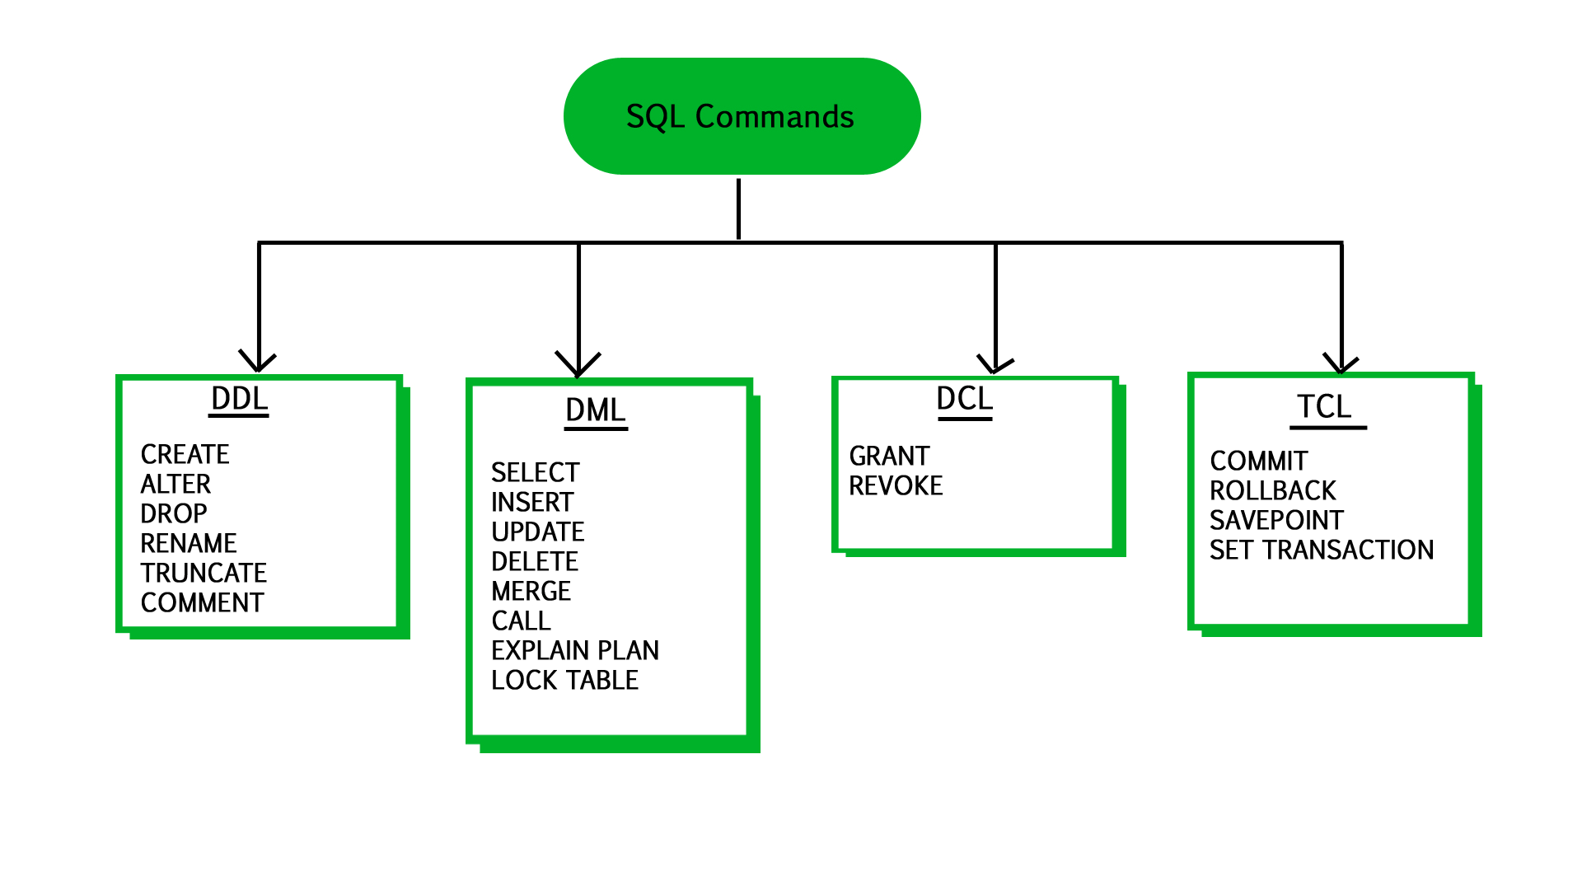
SQL Statements Categories

Slide 5

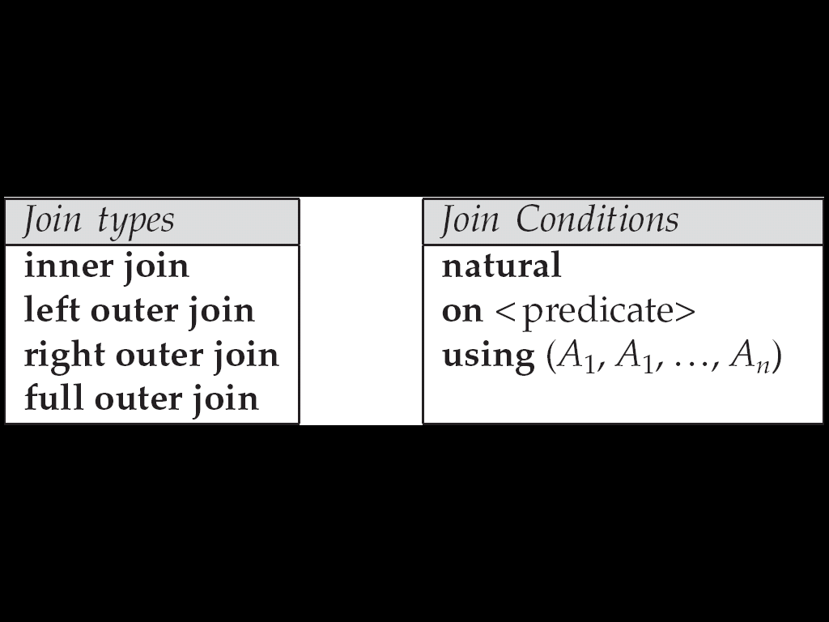
SQL Joins
Join operations take two relations and return as a result another relation.
A join operation is a Cartesian product which requires that tuples in the two relations match (under some condition). It also specifies the attributes that are present in the result of the join
The join operations are typically used as subquery expressions in the from clause
Join condition – defines which tuples in the two relations match, and what attributes are present in the result of the join.
Join type – defines how tuples in each relation that do not match any tuple in the other relation (based on the join condition) are treated.
v1

Slide 6
Index
Indices are data structures used to speed up access of records with specified values for index attributes.
Indexes are used to find rows with specific column values quickly.
Without an index, MySQL must begin with the first row and then read through the entire table to find the relevant rows. (Sequential Scan)
If the table has an index for the columns in question, MySQL can quickly determine the position to seek to in the middle of the data file without having to look at all the data.
This is much faster than reading every row sequentially
MySQL create default indexes on PRIMARY KEY, UNIQUE KEY
User defined index can be created using CREATE INDEX COMMAND
MySQL indices are stored in B-trees.

Slide 7
SQL Joins : Cross Join
Cross JOIN is a simplest form of JOINs which matches each row from one database table to all rows of another as a Cartesian product.
The cross join does not establish a relationship between the joined tables.
SELECT * FROM `Movies` CROSS JOIN `Artist` OR
SELECT * FROM `Movies` ,`Artist`;
Movies
Artist
Movie_id | Title | Category
1 | ASSASSIN'S CREED: | Animations
2 | Real Steel(2012) | Animations
Id | First_name | Last_name | Movie_id
1 | Adam | Smith | 1
2 | Ravi | Kumar | 2
v1

Slide 8
Cross Join of 2 tables
Movie_id | Title | Category | Id | First_name | Last_name | Movie_id
1 | ASSASSIN'S CREED: | Animations | 1 | Adam | Smith | 1
1 | ASSASSIN'S CREED: | Animations | 2 | Ravi | Kumar | 2
2 | Real Steel(2012) | Animations | 1 | Adam | Smith | 1
2 | Real Steel(2012) | Animations | 2 | Ravi | Kumar | 2

Slide 9
SQL Joins : Inner Join
The inner JOIN is used to return rows from both tables that satisfy the given condition(join condition on common column ).
SELECT * FROM movies INNER JOIN `Artist` on movies.movie_id` = Artist.movie_id
OR
SELECT * FROM movies ,Artist WHERE movies.movie_id = Artist.movie_id
Movie_id | Title | Category | Id | First_name | Last_name | Movie_id
1 | ASSASSIN'S CREED: | Animations | 1 | Adam | Smith | 1
2 | Real Steel(2012) | Animations | 2 | Ravi | Kumar | 2
v1

Slide 10
SQL Joins : Outer Join
MySQL Outer JOINs return all records matching from both tables .It can detect records having no match in joined table. It returns NULL values for records of joined table if no match is found.
SELECT A.title , B.first_name , B.last_name
FROM movies “A” LEFT OUTER JOIN Artist “ B”
ON B.`movie_id` = A. ‘movie_id’
# Some SQL Support keyword : Left join/natural left outer join
OR
SELECT A.title , B.first_name , B.last_name
FROM movies “A” LEFT OUTER JOIN Artist “ B” USING ( `movie_id` )
The LEFT JOIN returns all the rows from the table on the left even if no matching rows have been found in the table on the right.
Where no matches have been found in the table on the right, NULL is returned.
What will Right Outer return?
What will full outer return?
v1

Slide 11
Left outer join Output (contd..)
Movie_id | Title | Category
1 | ASSASSIN'S CREED: | Animations
2 | Real Steel(2012) | Animations
3 | Jurassic Park | Animation
Id | First_name | Last_name | Movie_id
1 | Adam | Smith | 1
2 | Ravi | Kumar | 2
Title | First_name | Last_name
ASSASSIN'S CREED: | Adam | Smith
Real Steel(2012) | Ravi | Kumar
Jurassic Park | Null | Null

Slide 12
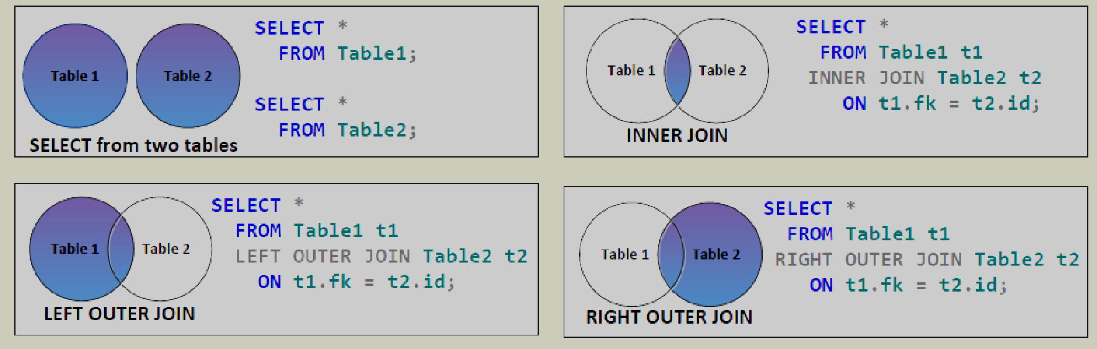
SQL Joins
v1

Slide 13
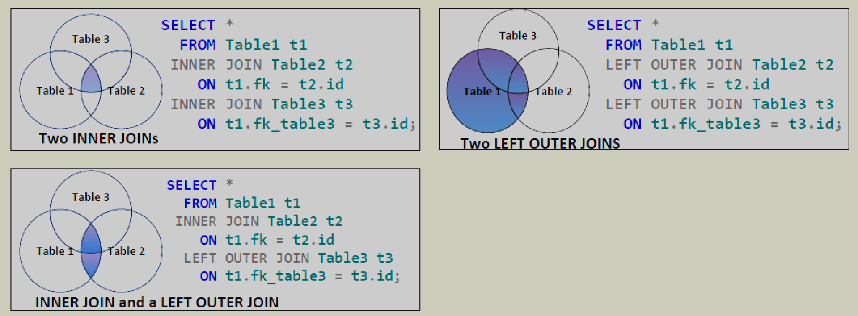
SQL Joins
v1

Slide 14
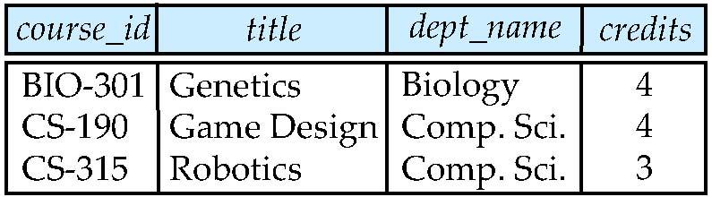
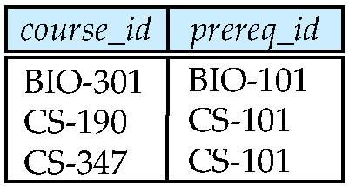
Join operations – Example
Relation course
Relation prereq
Observe that
prereq relation is missing for CS-315 and
course relation is missing for CS-347
v2

Slide 15
Outer Join
An extension of the join operation that avoids loss of information.
Computes the join and then adds tuples form one relation that does not match tuples in the other relation to the result of the join.
Uses null values.
v3

Slide 16
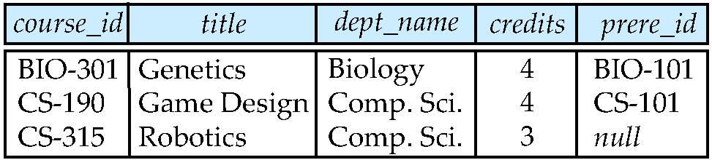
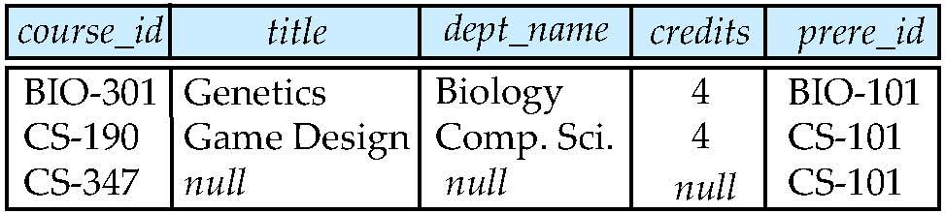
Left Outer Join And Right Outer Join
course natural left outer join prereq
course
course natural right outer join prereq
prereq
v4

Slide 17
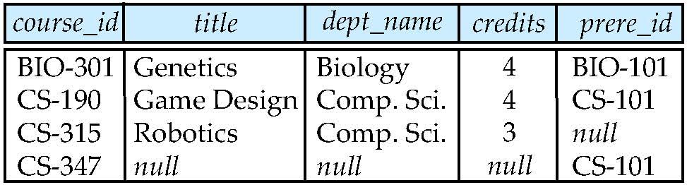
Full Outer Join
course natural full outer join prereq
course
prereq
v6

Slide 18
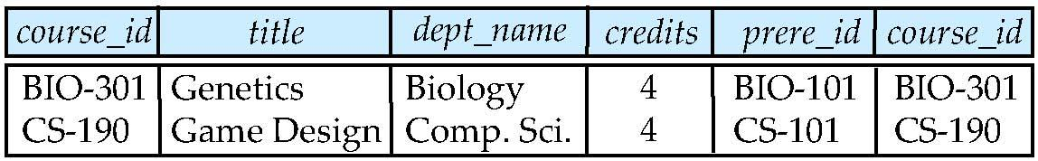
Joined Relations – Examples
The difference is in natural join no need to specify condition but in inner join condition is mandatory.
The repeated column is avoided in the output in natural join.
Select * from course natural join prereq
Select * from course inner join prereq on course.course_id = prereq.course_id
course
What is the difference between the above, and a natural join?
Select * from course left outer join prereq on course.course_id = prereq.course_id
prereq
v7

Slide 19
Joined Relations – Examples
course full outer join prereq using (course_id)
v8

Slide 20
Aggregate Functions
Type | Use | Functions
Single –row functions | Operate on a single column of a relation of single row n the table returning single value as an output | String functions, Date Functions
Multiple –row functions | Act on a multiple row in the relation returning single value as an output | Avg, min, max, sum, count
avg: average value min: minimum value max: maximum value sum: sum of values count: number of values

Slide 21
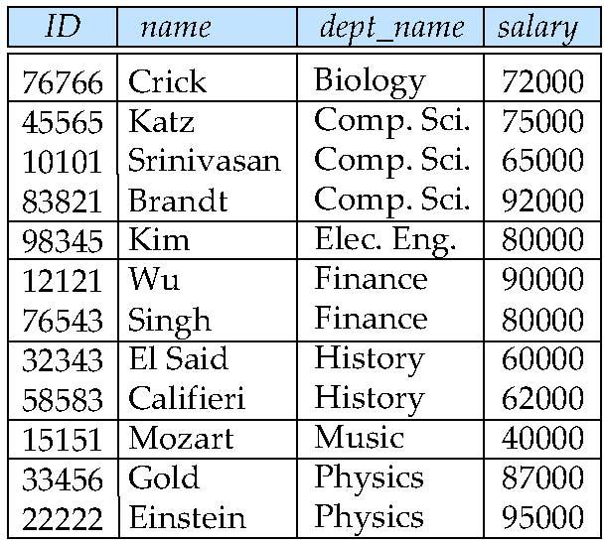
Aggregate Functions Examples
Find the average salary of instructors in the Computer Science department
select avg (salary),min(salary), max(salary),sum(salary) from instructor where dept_name= 'Comp. Sci.';
Find the number of tuples in the course relation
select count (*) from instructor;

Slide 22
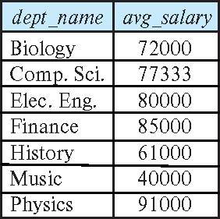
Aggregate Functions – Group By
Find the average salary of instructors in each department
select dept_name, avg (salary) as avg_salary from instructor group by dept_name;

Slide 23
Aggregation (Cont.)
Attributes in select clause outside of aggregate functions must appear in group by list
/* erroneous query */ select dept_name, ID, avg (salary) from instructor group by dept_name;
Discuss why query is erroneous, [Hint :refer last table]

Slide 24
Aggregate Functions – Having Clause
Find the names and average salaries of all departments whose average salary is greater than 42000
select dept_name, avg (salary) as avg_salary
from instructor
group by dept_name
having avg (salary) > 42000;
Note: predicates in the having clause are applied after the formation of groups whereas predicates in the where clause are applied before forming groups

Slide 25
Null Values and Aggregates
To find the total all salaries
select sum (salary ) from instructor
Above statement ignores null amounts
Result is null if there is no non-null amount
All aggregate operations except count(*) ignore tuples with null values on the aggregated attributes
What if collection has only null values?
count returns 0
all other aggregates return null

Slide 26
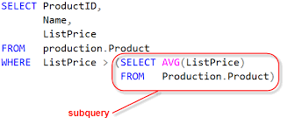
Subqueries (Nested Query)
A Subquery or Inner query or a Nested query is a query within another SQL query and embedded within the WHERE clause.
A subquery is used to return data that will be used in the main query as a condition to further restrict the data to be retrieved.
Subqueries can be used with the SELECT, INSERT, UPDATE, and DELETE statements along with the operators like =, <, >, >=, <=, IN, BETWEEN, etc.

Slide 27
Examples of Subquery in DML and Select
SQL> SELECT * FROM CUSTOMERS WHERE ID IN (SELECT ID FROM CUSTOMERS WHERE SALARY > 4500) ;
SQL> INSERT INTO CUSTOMERS_BKP SELECT * FROM CUSTOMERS WHERE ID IN (SELECT ID FROM CUSTOMERS) ;
SQL> UPDATE CUSTOMERS SET SALARY = SALARY * 0.25 WHERE AGE IN (SELECT AGE FROM CUSTOMERS_BKP WHERE AGE >= 27 );
SQL> DELETE FROM CUSTOMERS WHERE AGE IN (SELECT AGE FROM CUSTOMERS_BKP WHERE AGE >= 27 );

Slide 28
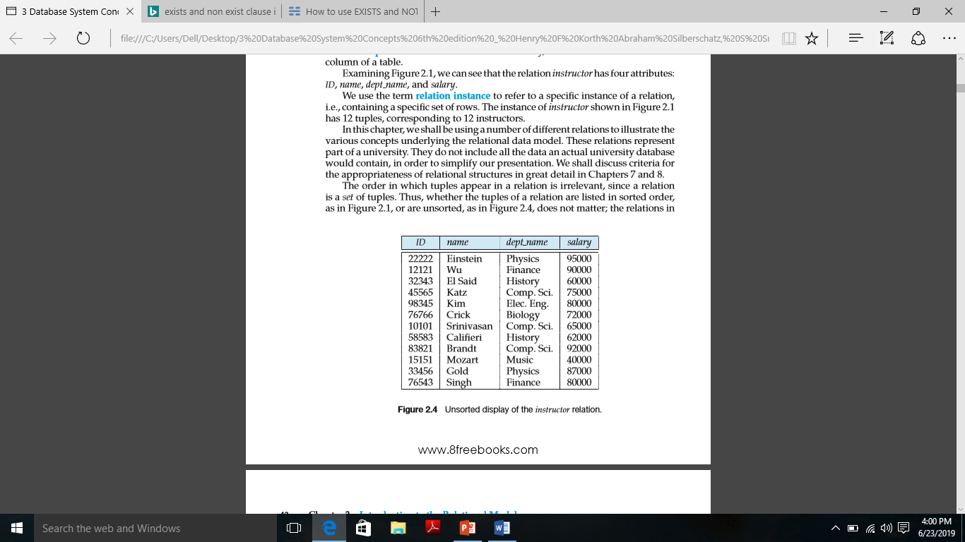
Subqueries in the From Clause
Find the average instructors’ salaries of those departments where the average salary is greater than $42,000.”
select dept_name, avg_salary from ( select dept_name, avg (salary) as avg_salary from instructor group by dept_name) where avg_salary > 42000;
Another way to write above query
select dept_name, avg_salary from ( select dept_name, avg (salary) from instructor group by dept_name)
as dept_avg (dept_name, avg_salary)
where avg_salary > 42000;

Slide 29
Set Operations
Set operations are union, intersect, and minus
Each of the above operations automatically eliminates duplicates
To retain all duplicates use the keyword all
union all,
intersect all
Minus
Select name from table1 union select name from table2;
Select * from table1 union select * from table 2;
table1
ID | NAME
1 | ABHI
2 | SAMEER
3 | SAMEER
ID | NAME
1 | ABHI
2 | SAMEER
3 | SAMEER
4 | JAVED
table2
ID | NAME
3 | SAMEER
4 | JAVED

Slide 30
Set Operations -examples
Select * from table1 intersect select * from table 2;
Select * from table1 minus select * from table 2;
Select * from table1 union all select * from table 2;
ID | NAME
1 | ABHI
2 | SAMEER
3 | SAMEER
ID | NAME
3 | SAMEER
table1
ID | NAME
3 | SAMEER
4 | JAVED
ID | NAME
1 | ABHI
2 | SAMEER
table2
ID | NAME
1 | ABHI
2 | SAMEER
3 | SAMEER
3 | SAMEER
4 | JAVED

Slide 31
Set Membership
Find courses offered in Fall 2017 and in Spring 2018
Find courses offered in Fall 2017 but not in Spring 2018
select distinct course_id
from section
where semester = 'Fall' and year= 2017 and course_id in (select course_id
from section
where semester = 'Spring' and year= 2018);
select distinct course_id
from section
where semester = 'Fall' and year= 2017 and course_id not in (select course_id
from section
where semester = 'Spring' and year= 2018);

Slide 32
Set Membership (Cont.)
Name all instructors whose name is neither “Mozart” nor Einstein”
select distinct name
from instructor
where name not in ('Mozart', 'Einstein')
instructor

Slide 33
Test for Empty Relations
EXISTS and NOT EXISTS are used with a subquery in WHERE clause to examine if the result the subquery returns is TRUE or FALSE.
The true or false value is then used to restrict the rows from outer query select.
As EXISTS and NOT EXISTS only return TRUE or FALSE in the subquery, the SELECT list in the subquery does not need to contain actual column name(s).

Slide 34
Continued…
SELECT * FROM customers WHERE EXISTS (SELECT * FROM order_details
WHERE customers.customer_id = order_details.customer_id);
SELECT * FROM customers WHERE NOT EXISTS (SELECT * FROM order_details WHERE customers.customer_id = order_details.customer_id);
Insert,update,delete commands can also be used with EXISTS commands
INSERT INTO contacts (contact_id, contact_name) SELECT supplier_id, supplier_name FROM suppliers WHERE EXISTS (SELECT * FROM orders WHERE suppliers.supplier_id = orders.supplier_id);
Delete from contacts SELECT supplier_id, supplier_name FROM suppliers WHERE EXISTS (SELECT * FROM orders WHERE suppliers.supplier_id = orders.supplier_id);

Slide 35
Exercises -Batch A
Perform Join Subqueries
SQL Queries on: Functions-Single Row, Aggregate Functions, Data Sorting, Subquery, Joins(Inner, Outer, Natural, Self), Group by-Having, Set Operations, View.TCL Commands ( Rollback, Commit, Savepoint)

Slide 36
Exercises 01
Create a database which consist of the following tables with appropriate constraints like primary key, foreign key, check constrains, not null etc.
Suppliers - S (S#, Name, Status, City)
Parts - P (P#, Pname, Colour, Weight, City)
Projects - J (J#, Jname, City)
Shipment - SPJ (S#, P#, J#, Qty)
Solve the following queries
Get S# for suppliers who supply project J1.
Get P# for parts supplied by a supplier in London.
Get the total quantity of part P1 supplied by S1.
Get project names for projects supplied by supplier S1.
Get colors of parts supplied by S1.
Get all part-color/part-city combinations.
Get J# for projects supplied by at least one supplier
Get colors of parts supplied by S1.
Delete all parts whose color is grren.
Create one view

Slide 37
Exercises 02
Create a database which consist of the following tables with appropriate constraints like primary key, foreign key, check constrains, not null etc.
employee (employee name, street, city) ,employee name is primary key
works (employee name, company name, salary)
company (company name, city) ,company name is primary key
manages (employee name, manager name)
Solve the following queries
Find the names of all employees who work for First Bank Corporation.
Find all employees who do not work for First Bank Coorporation
Find the company that has most employees.
Find all companies located in every in which small bank corporation is located
Find details of employee having salary greater than 10,000.
Update salary of all employees who work for First Bank Corporation by 10%.
Find employee and their managers.
Find the names, street and cities of all employees who work for First Bank Corporation and earn more than 10,000.
Find those companies whose employees earn a higher salary,on average, than th average salary at First Bank Corporation
Create one view

Slide 38
Exercises -Batch B
Perform Join and Subqueries
SQL Queries on: Functions-Single Row, Aggregate Functions, Data Sorting, Subquery, Joins(Inner, Outer, Natural, Self), Group by-Having, Set Operations, View.TCL Commands ( Rollback, Commit, Savepoint)

Slide 39
Exercises 01
Create a database which consist of the following tables with appropriate constraints like primary key, foreign key, check constrains, not null etc.
Hotel (HotelNo, Name, City) HotelNo is the primary key
Room (RoomNo, HotelNo, Type, Price)
Booking (HotelNo, GuestNo, DateFrom, DateTo, RoomNo)
Guest (GuestNo, GuestName, GuestAddress) GuestNo is primary key
Solve the following queries
How many hotels are there?
List the price and type of all rooms at the Grosvenor Hotel.
List the number of rooms in each hotel.
Update the price of all rooms by 5%.
List full details of all hotels in London.
What is the average price of a room?
List all guests currently staying at the Grosvenor Hotel.
List the number of rooms in each hotel in London.
Create one view on above database and query it.

Slide 40
Exercises 02
Create a database which consist of the following tables with appropriate constraints like primary key, foreign key, check constrains, not null etc.
emp (eno,ename,Zip,hdate)
parts(pno,pname,qty_on_hand, price)
customer(cno,cname,street,Zip,phone)
order(ono,cno,receivedate,shippeddate)
odetails(ono,pno,qty)
zipcode(Zip,city)
Solve the following queries
get pno,pname values of parts that are priced less than $20.00
get the ono & cname values of customer whose orders have not yet been shipped
get the cname values of customer who have placed order with emp living in ‘Pune’ or ‘mumbai’
get the cities in which customer or emp are located
get the totalquantity of part 1060 that has been ordered
get the total no of customer
Create one view

Slide 41
Exercises -Batch C
Perform Join and Subqueries
SQL Queries on: Functions-Single Row, Aggregate Functions, Data Sorting, Subquery, Joins(Inner, Outer, Natural, Self), Group by-Having, Set Operations, View.TCL Commands ( Rollback, Commit, Savepoint)

Slide 42
Exercises 01
Create a database which consist of the following tables with appropriate constraints like primary key, foreign key, check constrains, not null etc.
Project(project_id,proj_name,chief_arch) project_id is primary key
Employee(Emp_id,Emp_name) Emp_id is primary key
Assigned-To(Project_id,Emp_id)
Solve the following queries
Get the details of employees working on project C353
Get employee number of employees working on project C353
Obtain details of employees working on Database project
Get details of employees working on both C353 and C354
Get employee numbers of employees who do not work on project C453
Get details of all employee whose name start with S.
Get details of all projects whose chief_arch is ‘Smith’
Delete all project whose proj_name is ‘DBMS’
Get project_id of Emp_id 101.
Create one view

Slide 43
Exercises 02
Create a database which consist of the following tables with appropriate constraints like primary key, foreign key, check constrains, not null etc.
Employee(emp_no,name,skill,pay-rate) eno primary key
Position(posting_no,skill) posting_no primary key
Duty_allocation(posting_no,emp_no,day,shift)
Solve the following queries
Get the duty allocation details for emp_no 123461 for the month of April 1986.
Find the shift details for Employee ‘xyz’
Get employees whose rate of pay is more than or equal to the rate of pay of employee ‘xyz’
Get the names and pay rates of employees with emp_no less than 123460 whose rate of pay is more than the rate of pay of at least one employee with emp_no greater than or equal to 123460.
Find the names of employees who are assigned to all positions that require a Chef’s skill
Get the employee numbers of all employees working on at least two dates.
Get a list of names of employees with the skill of Chef who are assigned a duty
Get a list of employees not assigned a duty
Get a count of different employees on each shift
Create one view

Slide 44
Exercises -Batch D
Perform Join and Subqueries
SQL Queries on: Functions-Single Row, Aggregate Functions, Data Sorting, Subquery, Joins(Inner, Outer, Natural, Self), Group by-Having, Set Operations, View.TCL Commands ( Rollback, Commit, Savepoint)

Slide 45
Exercises 01
Create a database which consist of the following tables with appropriate constraints like primary key, foreign key, check constrains, not null etc.
Account(Acc_no, branch_name,balance)
branch(branch_name,branch_city,assets)
customer(cust_name,cust_street,cust_city)
Depositor(cust_name,acc_no)
Loan(loan_no,branch_name,amount)
Borrower(cust_name,loan_no)
Solve the following queries
Find all loan numbers for loans made at Akurdi Branch with loan amount > 12000.
Find all customers who have a loan from bank. Find their names,loan_no and loan amount.
List all customers in alphabetical order who have loan from Akurdi branch.
Find all customers who have an account or loan or both at bank.
Find all customers who have both account and loan at bank.
Find all customer who have account but no loan at the bank.
Find average account balance at Akurdi branch.
Find the average account balance at each branch
Find no. of depositors at each branch.
Find the branches where average account balance > 12000.

Slide 46
Create a database which consist of the following tables with appropriate constraints like primary key, foreign key, check constrains, not null etc.
Sailors ( Sid , same , rating age)
Boats(bid , bname, color)
Reserves (sid, bid, day(date))
Solve the following queries
find the sid of sailors who have reserved the a red boat
find the name of sailors who have reserved the red boat
find the color of boats reserved by ‘john’
find the sid of sailors who have traveled in the month ‘april’
find all sailors with less than 7 rating.
Create one view

Slide 47
Thank You!

